Slide 1
Chapter 1
The Nature of Probability
and Statistics

Slide 2
課前練習
分組: 10人一組
選定主題:
1. 手機: 手機電信業者為何? 每月平均通話費用
2. 何時開始使用FB? FB好友數
3. 學測科目中最喜愛的科目為何? 獲得幾級分?
4. 開始配戴眼鏡的時間? 目前近視度數?
5. 對於昨天放颱風假的心情? 昨日一天的花費
(非常開心、開心、普通、不開心、非常不開心)

Slide 3
Chapter 1 Overview
Introduction
1-1 Descriptive and Inferential Statistics
1-2 Variables and Types of Data
1-3 Data Collection & Sampling Techniques
1-4 Observational and Experimental Studies
1-5 Uses and Misuses of Statistics
1-6 Computers and Calculators

Slide 4
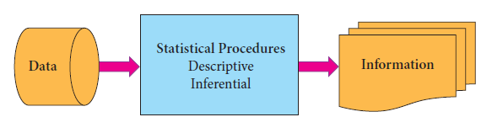
Introduction
Statistics is the science of conducting studies to
Collect, organize, summarize, analyze, and draw conclusions from data.

Slide 5
母體
(Population)
隨機
抽取
樣本
(Sample)
敘述
統計學
整理及展示
母體資料
整理及展示
樣本資料
分析母體資料
➔參數
分析樣本資料
➔統計量
統計學
解釋母體特徵
解釋樣本特徵
推論
統計學
推論母體特徵
資料來源：交通大學工業工程與管理學系 唐麗英教授

Slide 6
解決統計問題的五大步驟
問題定義
資料收集
各種抽樣方法
資料整理
統計圖表
常用統計量
信賴區間
假設檢定
變異數分析(ANOVA)
迴歸分析
資料分析
結論與決策
可信度
資料來源：交通大學工業工程與管理學系 唐麗英教授

Slide 7
Section 1-1
Descriptive and
Inferential Statistics

Slide 8
Terminology
Variable
A variable is a characteristic or attribute that can assume different values.
Data
The values that a variable can assume are called data.
Population
A population consists of all subjects (human or otherwise) that are studied.
Sample
A sample is a subset of the population.

Slide 9
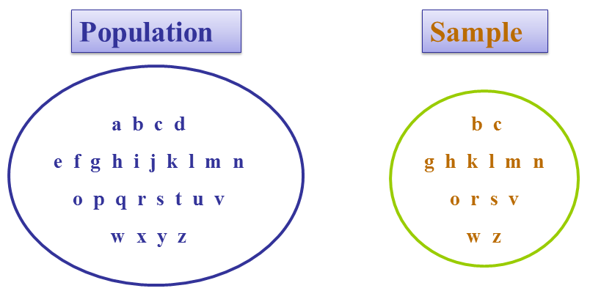
Populations and Sample

Slide 10
Descriptive and Inferential Statistics
Descriptive statistics
Procedures and techniques designed to describe data
Consists of the collection, organization, summarization, and presentation of data.
Inferential statistics
Tools and techniques that help decision makers to draw inferences from a set of data
Consists of generalizing from samples to populations, performing estimations and hypothesis tests, determining relationships among variables, and making predictions.

Slide 11
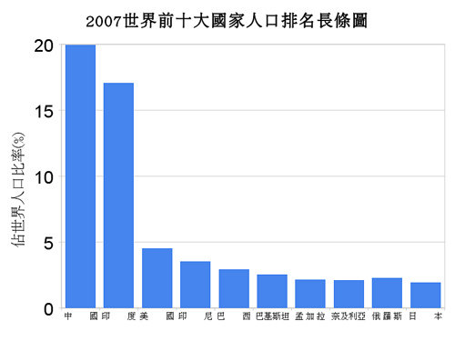
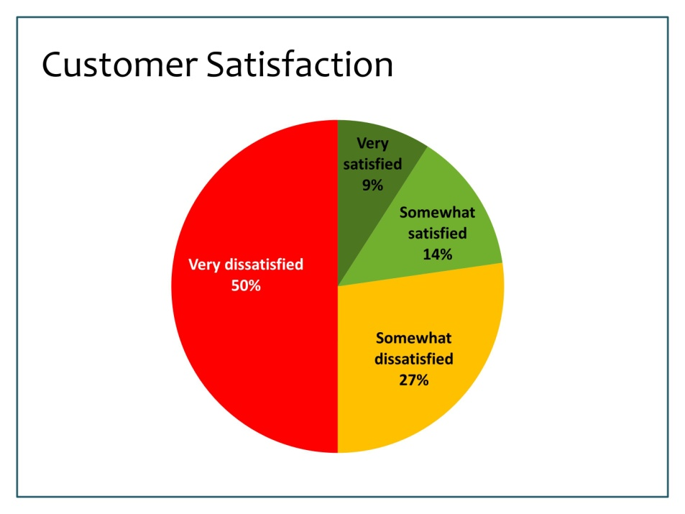
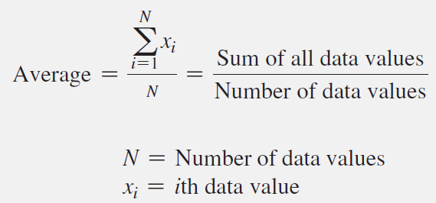
Descriptive Statistics
Charts and graphs
Numerical measures

Slide 12
Inferential Procedures
Estimation
e.g., Estimate the population mean weight using the sample mean weight
Hypothesis Testing
e.g., Use sample evidence to test the claim that the population mean weight is 65 kg.

Slide 13
Section 1-2
Variables and Types of Data

Slide 14
Variables and Types of Data
Data
Qualitative
Categorical
Quantitative
Numerical,
Can be ranked
Discrete
Countable
5, 29, 8000, etc.
Continuous
Can be decimals
2.59, 312.1, etc.

Slide 15
Variables and Types of Data
性別
血型
身高
體重
每天上網時間
手機重量

Slide 16
Recorded Values and Boundaries
Variable | Recorded Value | Boundaries
Length | 15 cm
Temperature | 36 °C
Time | 0.43 second (sec)
Mass | 1.6 grams (g)
14.5-15.5 cm
35.5-36.5 °C
0.425-0.435 sec
1.55-1.65 g

Slide 17
測量尺度的類型
名目尺度
Nominal Scale
順序尺度
Ordinal Scale
區間尺度
Interval Scale
比率尺度
Ratio Scale
Notes:
Students will be building their measurement questions from different types of scales. They need to know the difference in order to choose the appropriate type. Each scale type has its own characteristics.

Slide 18
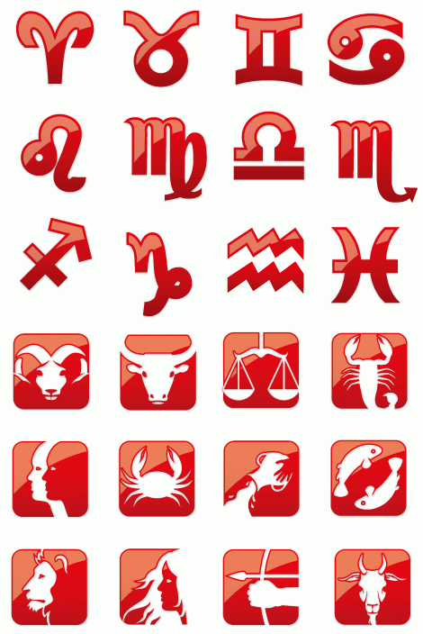


名目尺度 (Nominal Scale)
互斥且周延，但無順序、距離或原點
只有分類的特性
Notes:
Nominal scales collect information on a variable that can be grouped into categories that are mutually exclusive and collectively exhaustive. For example, symphony patrons could be classified by whether or not they had attended prior performances.
The counting of members in each group is the only possible arithmetic operation when a nominal scale is employed. If we use numerical symbols within our mapping rule to identify categories, these numbers are recognized as labels only and have no quantitative value.
Nominal scales are the least powerful of the four data types. They suggest no order or distance relationship and have no arithmetic origin. The researcher is restricted to use of the mode as a measure of central tendency. The mode is the most frequently occurring value. There is no generally used measure of dispersion for nominal scales. Dispersion describes how scores cluster or scatter in a distribution.
Even though LeBron James wears #23, it doesn’t mean that he is better player than #24 or a worse player than #22. The number has no meaning other than identifying James for someone who doesn’t follow the Cavs.

Slide 19
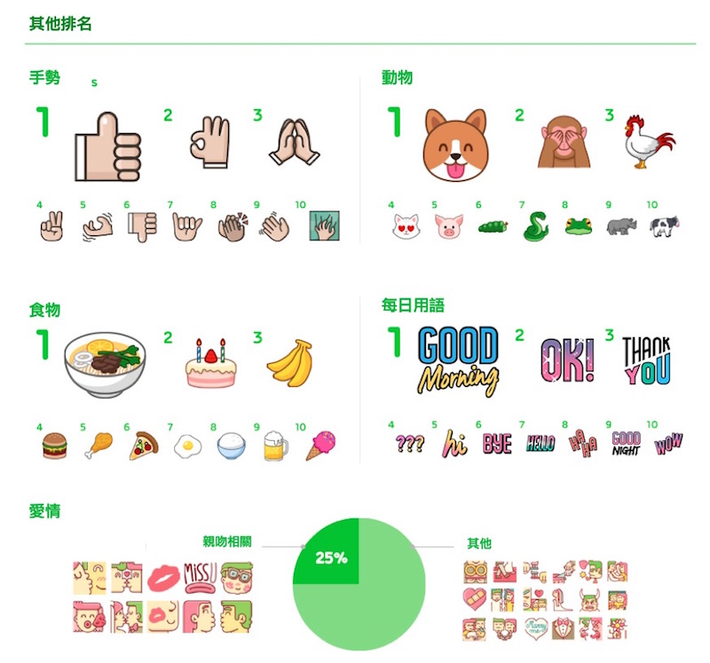

順序尺度(Ordinal Scale)
衡量有重要、大小、強弱、好壞程度等級順序之資料
但無法衡量不同等級間的差異大小，此種類型資料之數學四則運算沒有任何意義。
Notes:
Ordinal data require conformity to a logical postulate, which states:
If a is greater than b, and
b is greater than c, then
a is greater than c.
Rankings are examples of ordinal scales. Attitude and preference scales are also ordinal.
The appropriate measure of central tendency is the median. The median is the midpoint of a distribution. A percentile or quartile reveals the dispersion.
Nonparametric tests should be used with nominal and ordinal data. This is due to their simplicity, statistical power, and lack of requirements to accept the assumptions of parametric testing.

Slide 20
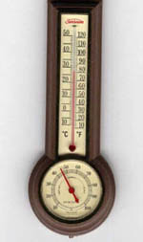
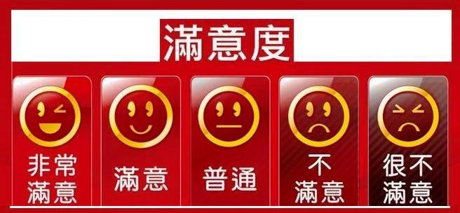
區間尺度 (Interval Scale)
分類、順序及距離，但無原點
區間或距離是否相等
Notes:
Researchers treat many attitude scales as interval (this will be illustrated in the next chapter).
When a scale is interval and the data are relatively symmetric with one mode, one can use the arithmetic mean as the measure of central tendency. The standard deviation is the measure of dispersion.
The product-moment correlation, t-tests, F-tests, and other parametric tests are the statistical procedures of choice for interval data.

Slide 21
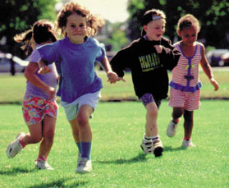
比率尺度(Ratio Scale)
分類、順序、距離及原點
例子
體重
身高
孩童數目
Notes:
Examples
Weight
Height
Number of children
Ratio data represent the actual amounts of a variable.
In business research, there are many examples such as monetary values, population counts, distances, return rates, and amounts of time.
All statistical techniques mentioned up to this point are usable with ratio scales. Geometric and harmonic means are measures of central tendency and coefficients of variation may also be calculated.
Higher levels of measurement generally yield more information and are appropriate for more powerful statistical procedures.

Slide 22
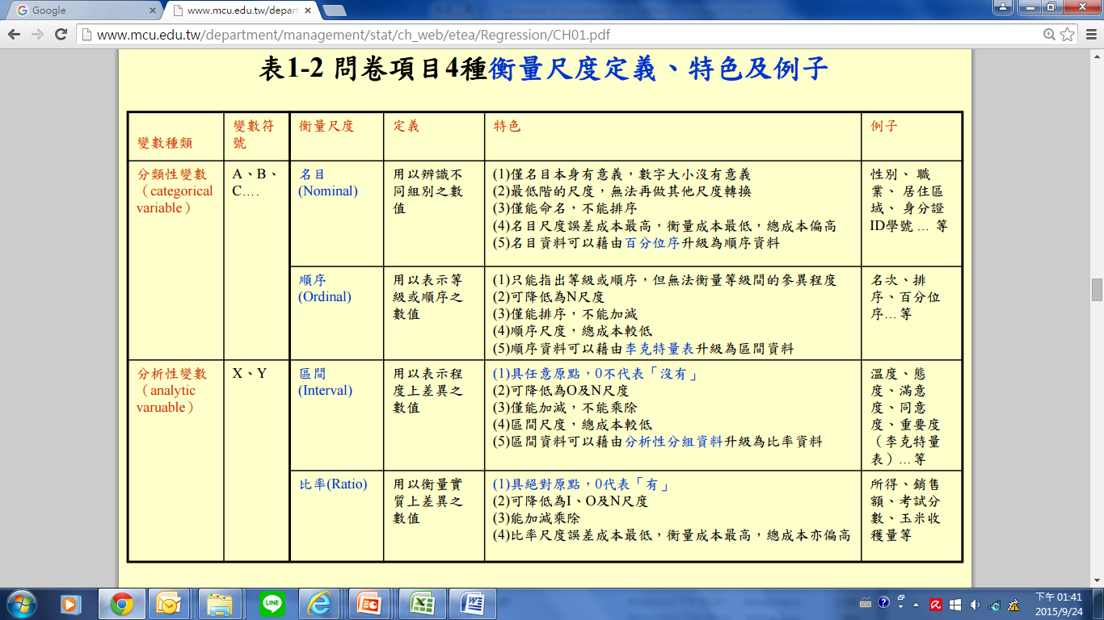
問卷項目之衡量尺度定義及特色

Slide 23
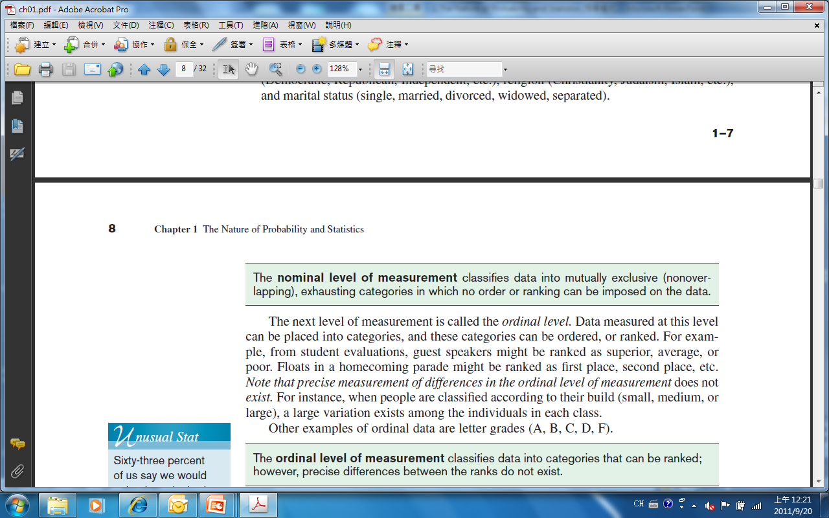
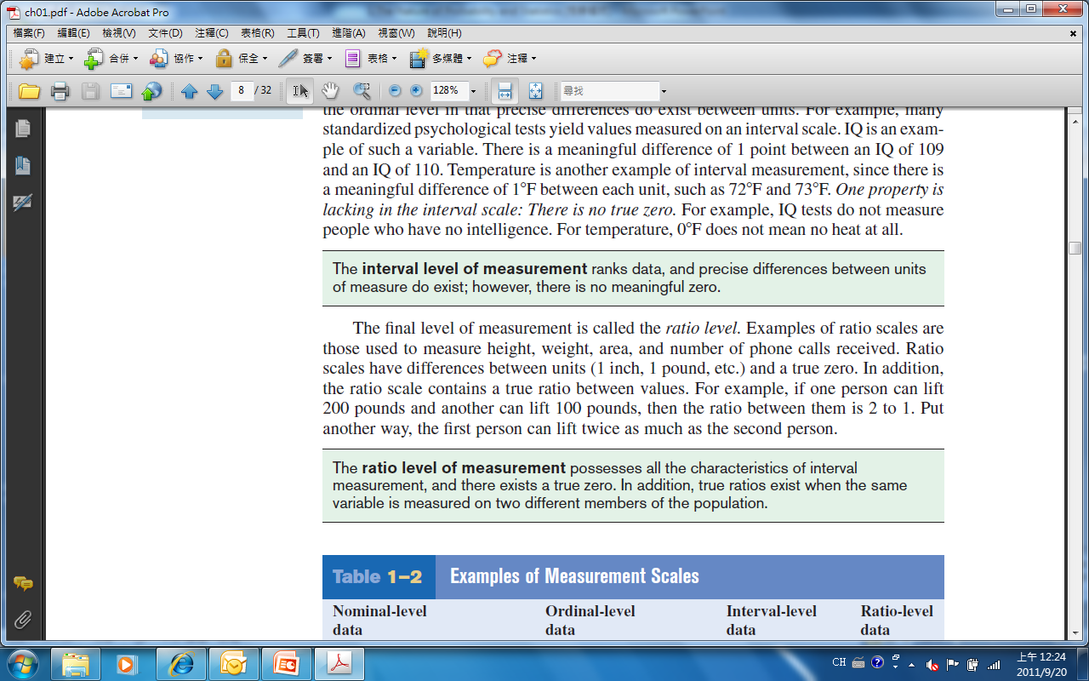
Levels of Measurement
Nominal – categorical (names)
Ordinal – nominal, plus can be ranked (order)
Interval – ordinal, plus intervals are consistent
Ratio – interval, plus ratios are consistent, true zero

Slide 24
Levels of Measurement
Example:
Variable
Nominal
Ordinal
Interval
Ratio
Level
Hair Color
Yes
No
Nominal
Zip Code
Yes
No
Nominal
Letter
Grade
Yes
Yes
No
Ordinal
ACT Score
Yes
Yes
Yes
No
Interval
Height
Yes
Yes
Yes
Yes
Ratio
Age
Yes
Yes
Yes
Yes
Ratio
Temperature
Yes
Yes
Yes
No
Interval

Slide 25
測量尺度的類型
名目尺度
Nominal Scale
分類
分類
順序尺度
Ordinal Scale
分類
順序
區間尺度
Interval Scale
分類
距離
順序
比率尺度
Ratio Scale
分類
距離
順序
原點
Notes:
In measuring, one devises some mapping rule and then translates the observation of property indicants using this rule.
Mapping rules have four characteristics and these are named in the slide.
Classification means that numbers are used to group or sort responses.
Order means that the numbers are ordered. One number is greater than, less than, or equal to another number.
Distance means that differences between numbers can be measured.
Origin means that the number series has a unique origin indicated by the number zero.
Combinations of these characteristics provide four widely used classifications of measurement scales: nominal, ordinal, interval, and ratio.

Slide 26
衡量尺度
資料
定性資料
定量資料
數值
非數值
數值
名目
尺度
順序
尺度
名目
尺度
順序
尺度
區間
尺度
比例
尺度

Slide 27
Section 1-3
Data Collection and
Sampling Techniques

Slide 28
Some Sampling Techniques
Random – random number generator
Systematic – every k^{th} subject
Stratified – divide population into “layers”
Cluster – use intact groups
Convenient – mall surveys

Slide 29
Section 1-4
Observational and Experimental Studies

Slide 30
Type of the studies
Observational study
In an observational study, the researcher merely observes and tries to draw conclusions based on the observations.
Experimental study
The researcher manipulates the independent (explanatory) variable and tries to determine how the manipulation influences the dependent (outcome) variable in an experimental study.

Slide 31
Section 1-5
Uses and Misuses
of Statistics

Slide 32
Uses and Misuses of Statistics
Suspect Samples
Is the sample large enough?
How was the sample selected?
Is the sample representative of the population?
Ambiguous Averages
What particular measure of average was used and why?

Slide 33
Uses and Misuses of Statistics
Misleading Graphs
Are the scales for the x-axis and y-axis appropriate for the data?
Faulty Survey Questions
Do you feel that statistics teachers should be paid higher salaries?
Do you favor increasing tuition so that colleges can pay statistics teachers higher salaries?

Slide 34
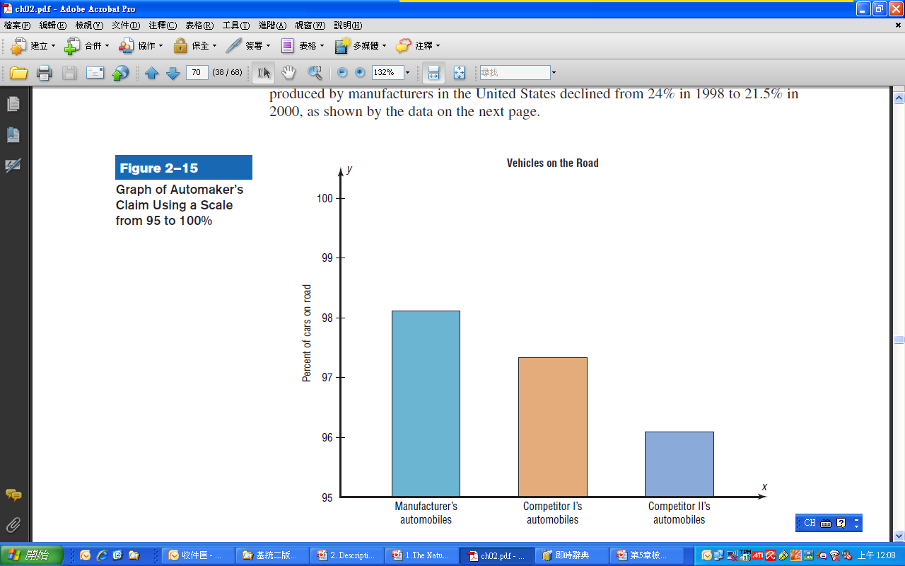
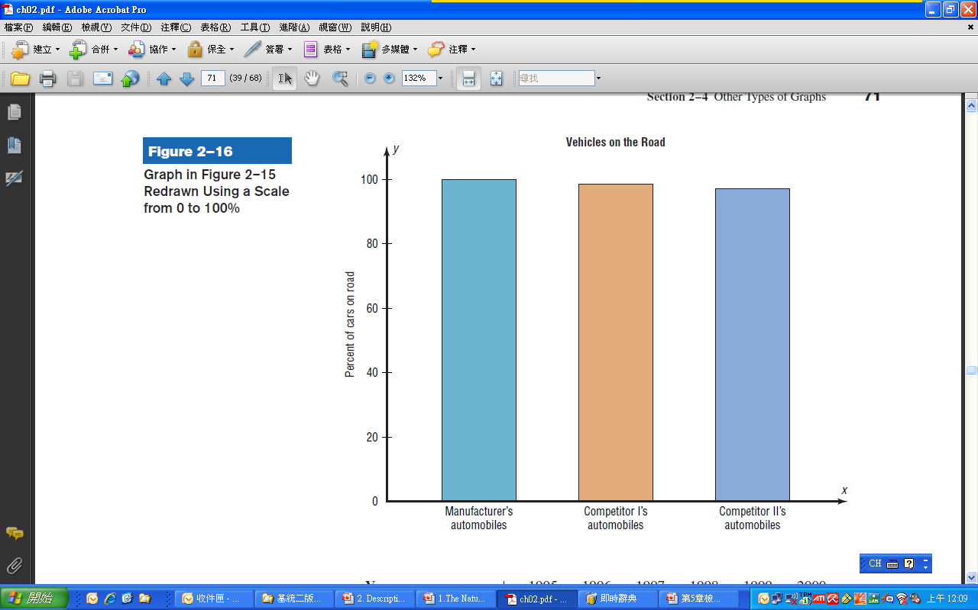
Misleading Graphs

Slide 35
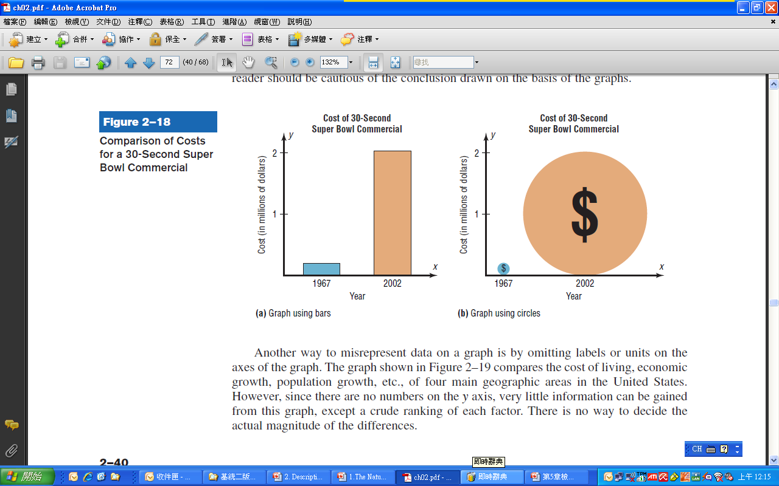
Misleading Graphs

Slide 36
Computers and Calculators
Microsoft Excel
Minitab
SAS
SPSS

